Slide 1


Introduction to Variant Analysis
https://tinyurl.com/Intro-to-variant-analysis
Harvard Chan Bioinformatics Core

Slide 2

Introductions!

Slide 3


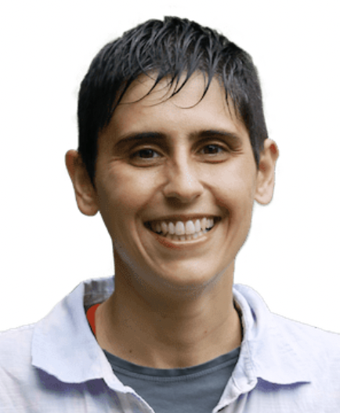
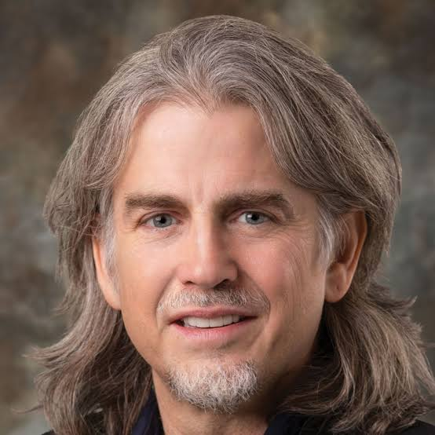
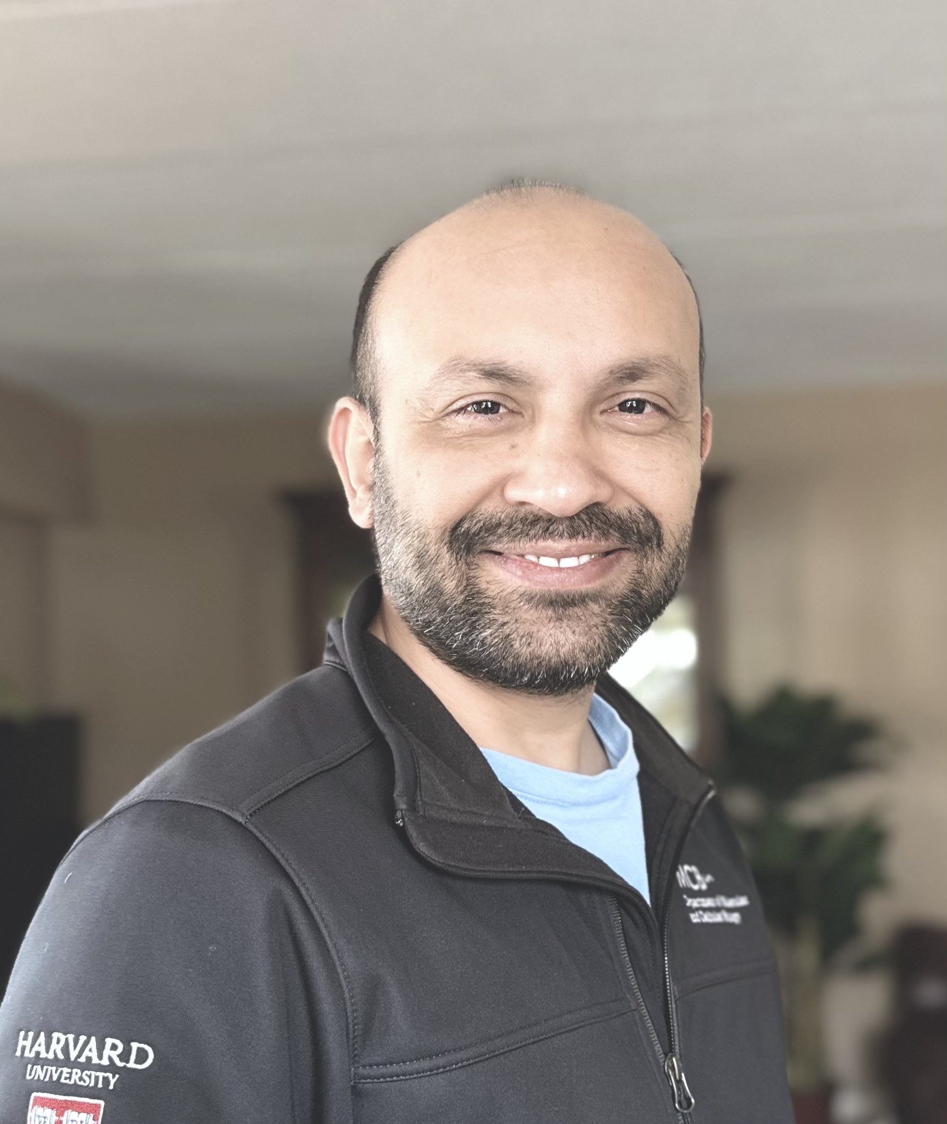
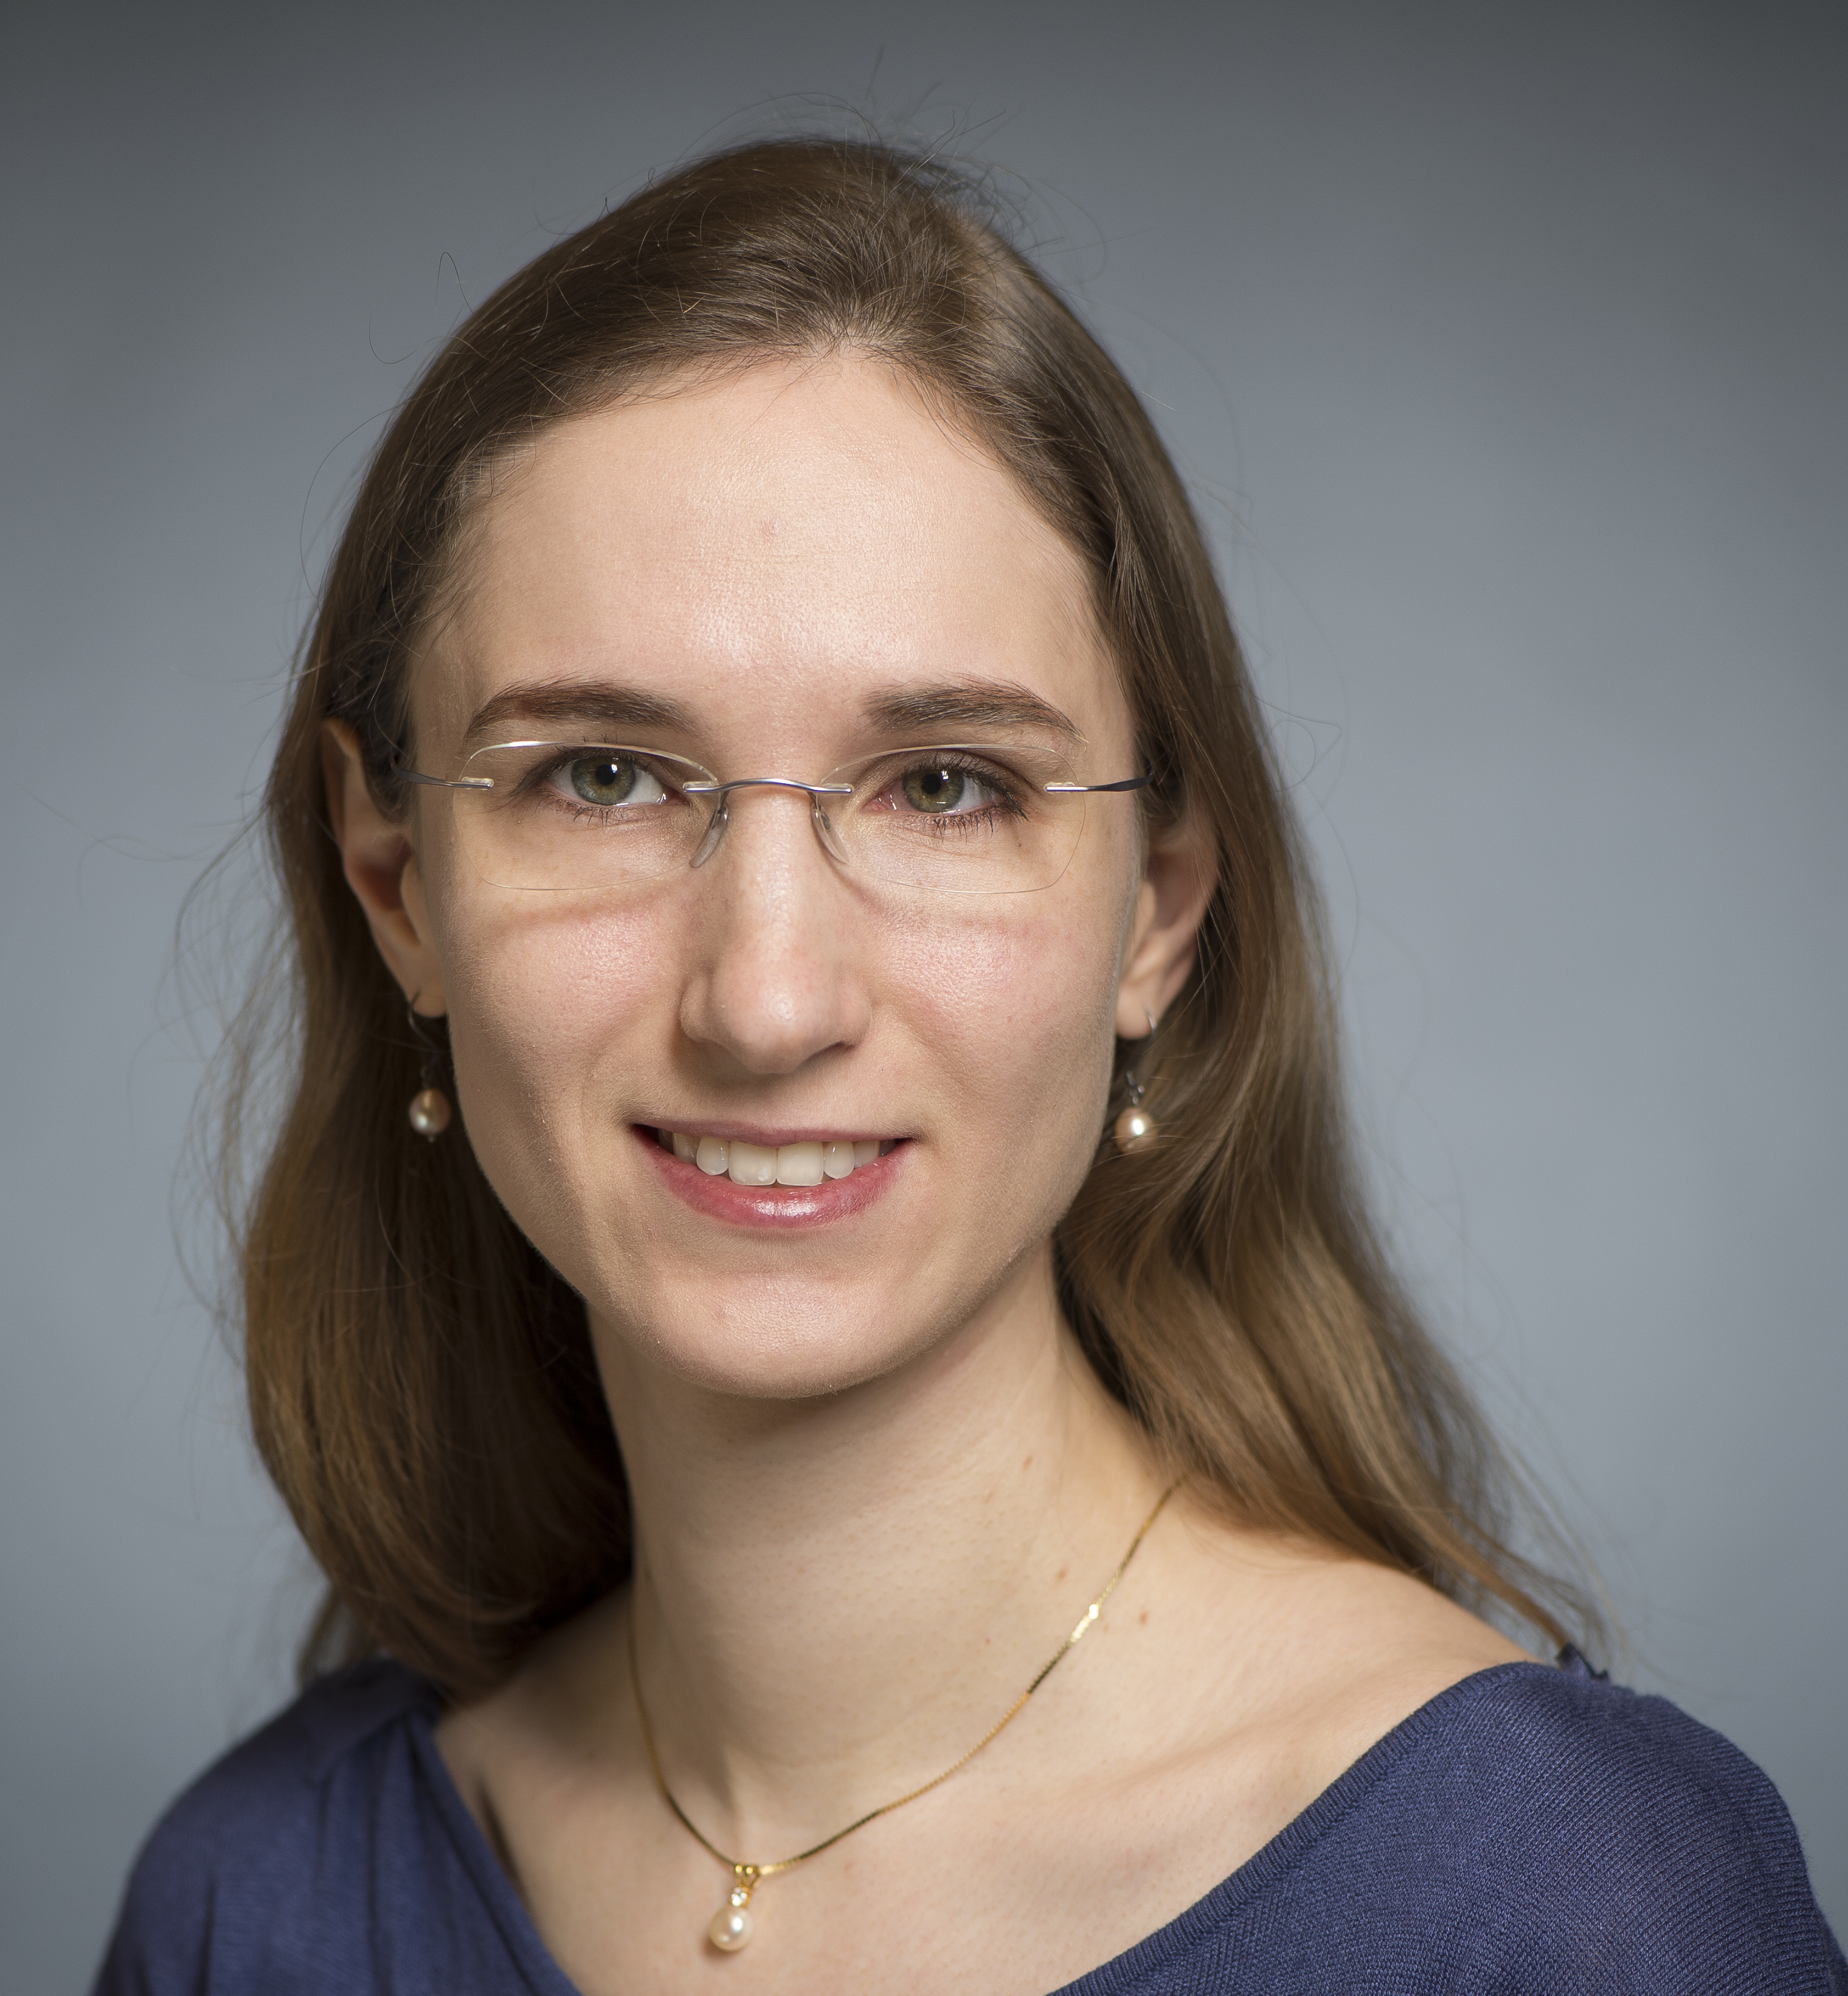
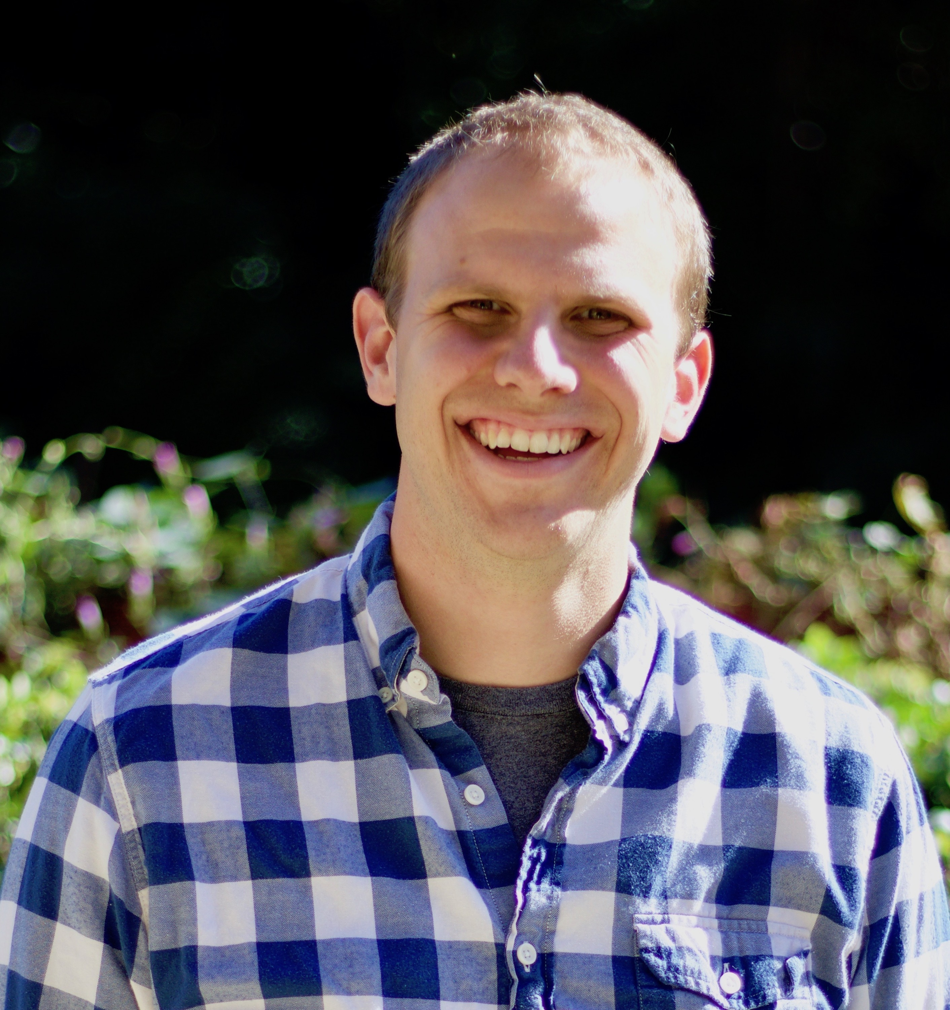
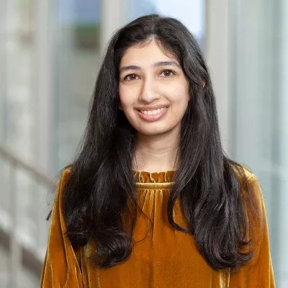
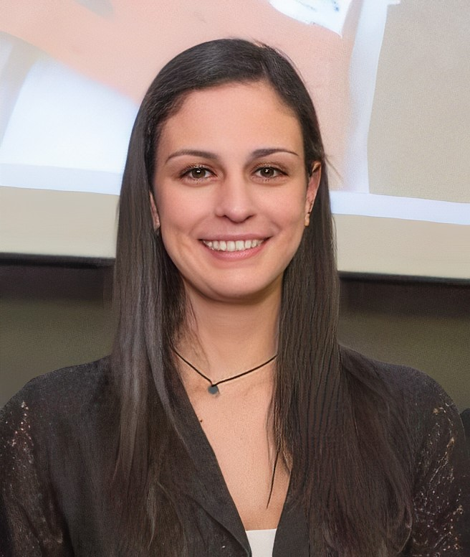
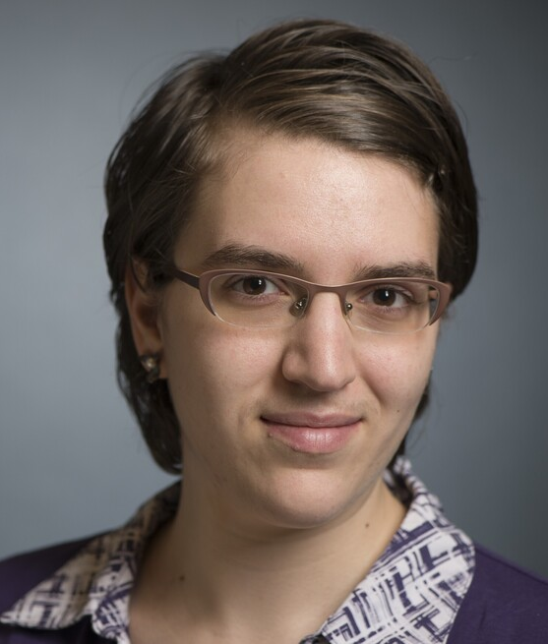

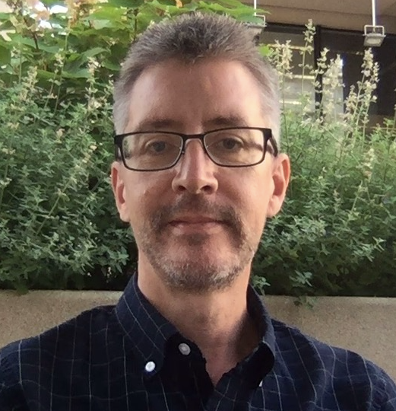
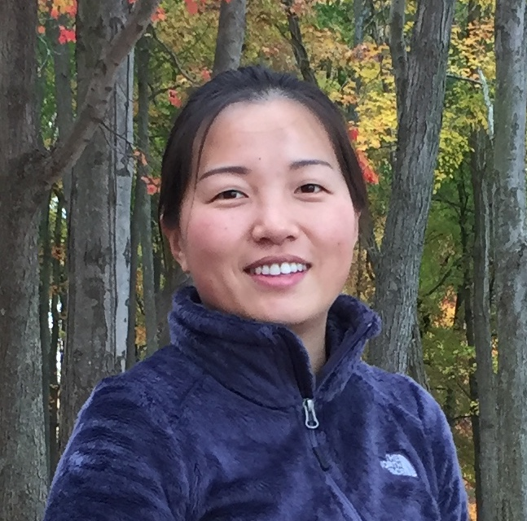
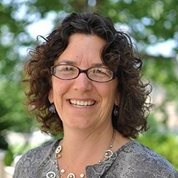
Shannan Ho Sui
Director
Meeta Mistry
Associate Director
Lorena Pantano
Director of Bioinformatics Platform
John Quackenbush
Faculty Advisor
Heather Wick
Noor Sohail
Upen Bhattarai
Heather Wick
Will Gammerdinger
Noor Sohail
Alex Bartlett
Elizabeth Partan
Emma Berdan
James Billingsley
Zhu Zhuo
Maria Simoneau

Slide 4
Shannan Ho Sui
Director
Meeta Mistry
Associate Director
Lorena Pantano
Director of Bioinformatics Platform
John Quackenbush
Faculty Advisor
Heather Wick
Noor Sohail
Upen Bhattarai
Heather Wick
Will Gammerdinger
Noor Sohail
Alex Bartlett
Elizabeth Partan
Emma Berdan
James Billingsley
Zhu Zhuo
Maria Simoneau

Slide 5
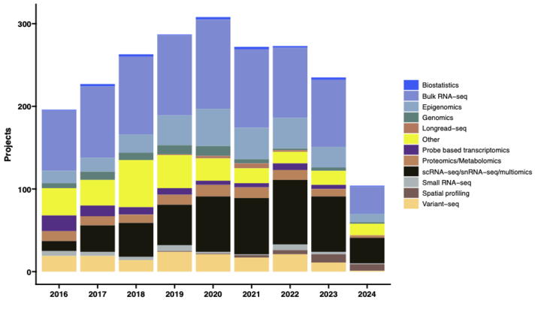
Consulting
Transcriptomics: Bulk, single cell, small RNA
Epigenomics: ChIP-seq, CUT&RUN, ATAC-seq, DNA methylation
Variant discovery: WGS, resequencing, exome-seq and CNV
Multiomics integration
Spatial biology
Experimental design and grant support
https://bioinformatics.sph.harvard.edu/services

Slide 6




Consulting
Transcriptomics: Bulk, single cell, small RNA
Epigenomics: ChIP-seq, CUT&RUN, ATAC-seq, DNA methylation
Variant discovery: WGS, resequencing, exome-seq and CNV
Multiomics integration
Spatial biology
Experimental design and grant support
NIEHS

Slide 7
Training
Hands-on workshops design to reflect best practices, reproducibility and an emphasis on experimental design
Basic Data Skills
Shell
R
Advanced Topics: Analysis of high-throughput sequencing data
Chromatin Biology
Bulk RNA-seq
Differential Gene Expression
scRNA-seq
Variant Calling
Current Topics in Bioinformatics
https://bioinformatics.sph.harvard.edu/training

Slide 8

Training
Hands-on workshops design to reflect best practices, reproducibility and an emphasis on experimental design
Basic Data Skills
Shell
R
Advanced Topics: Analysis of high-throughput sequencing data
Chromatin Biology
Bulk RNA-seq
Differential Gene Expression
scRNA-seq
Variant Calling
Current Topics in Bioinformatics
https://bioinformatics.sph.harvard.edu/training

Slide 9

Join us for HBC Community Breakfast!
An opportunity to get to know others in the community
Free food and beverages
Great conversations
Thursday June 6th, 2024
9:00 to 10:30am
More Info: http://bioinformatics.sph.harvard.edu/breakfast/

Slide 10
Workshop scope

Slide 11
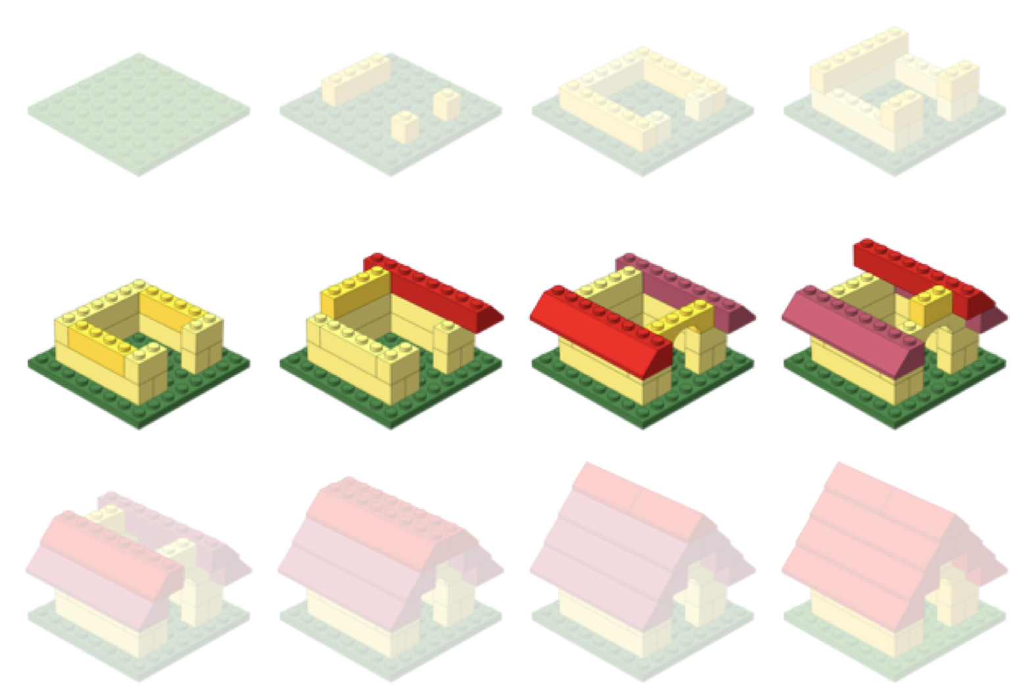
Bioinformatic Data Analysis

Slide 12
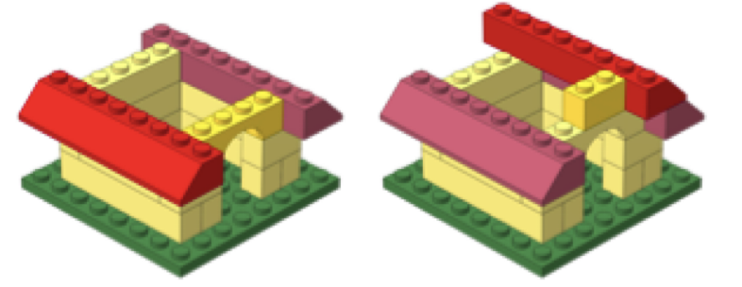
Variant Analysis
Variant Calling identifies loci in the genome/exome where allelic variation exist
Variant Annotation integrates outside databases and information to provide alleles with context on potential functional impacts
Variant Prioritization allows a framework through which a researcher can filter through their annotated variants to find ones of potential interest

Slide 13
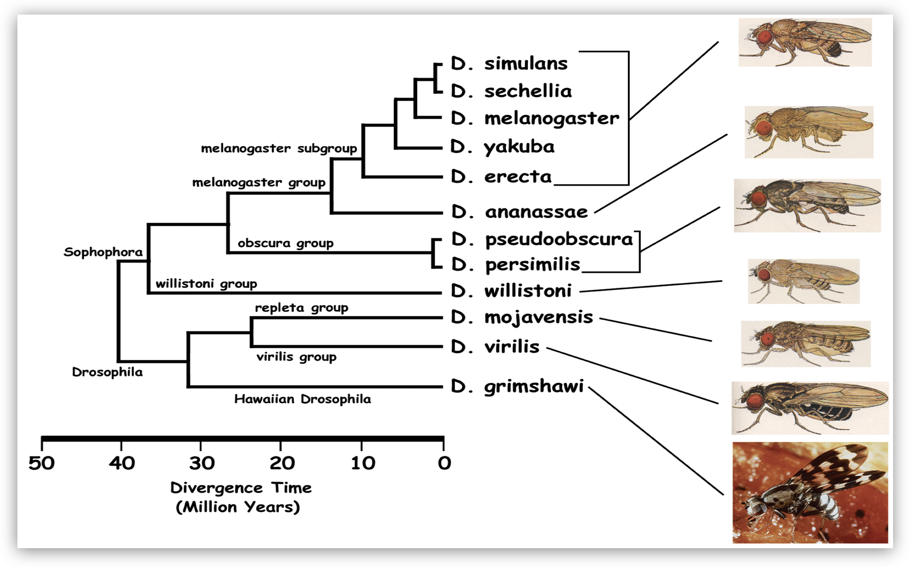
Applications
Evolutionary Biology
http://insects.eugenes.org/DroSpeGe/

Slide 14
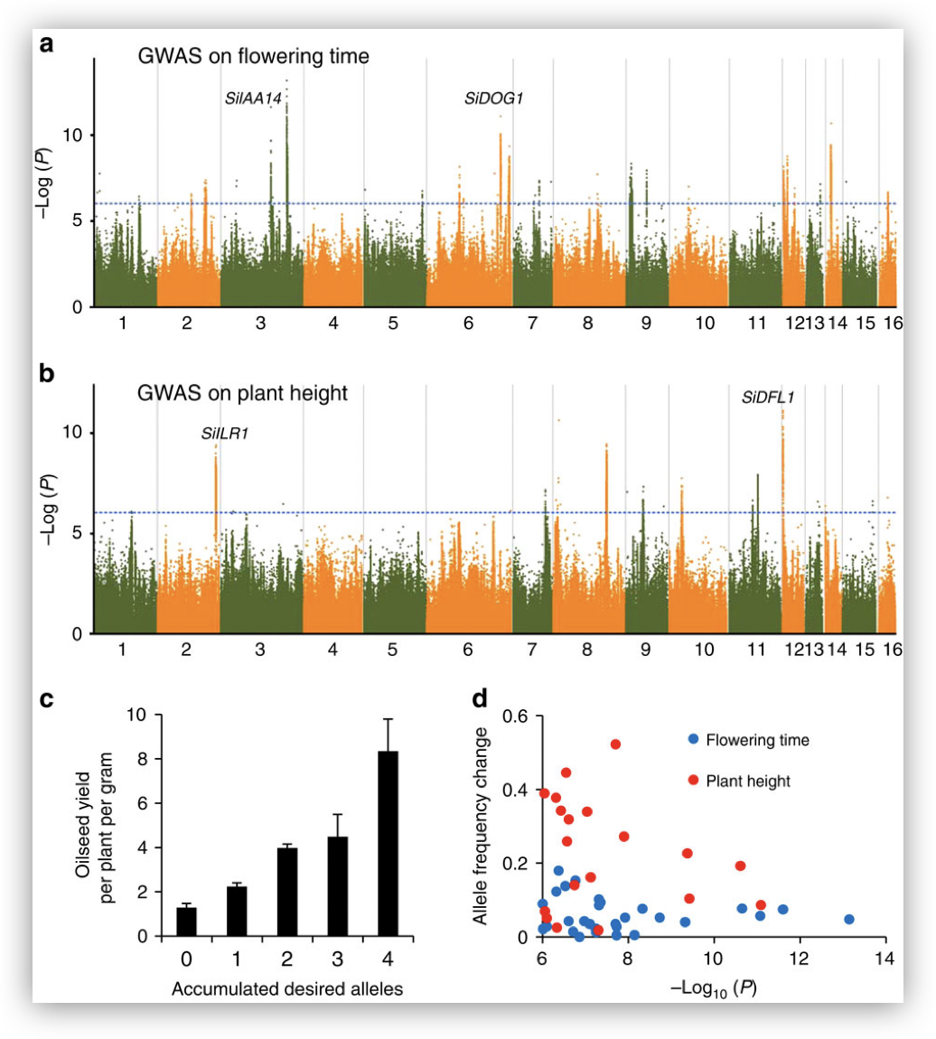
Applications
Evolutionary Biology
Agriculture
http://www.nature.com/ncomms/2015/151019/ncomms9609/fig_tab/ncomms9609_F6.html

Slide 15
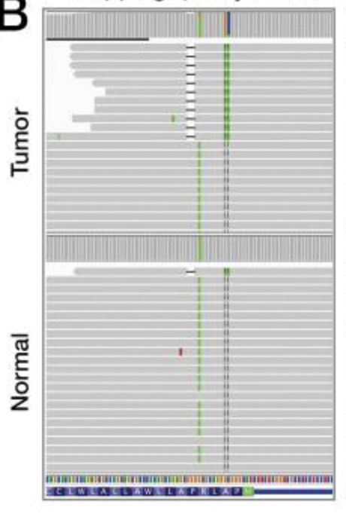
Applications
Evolutionary Biology
Agriculture
Clinical Applications
Tracking infectious disease
Identifying alleles responsible for heredity diseases
Interrogating potential drivers of cancer from
paired tumor-normal samples
https://www.ncbi.nlm.nih.gov/pmc/articles/PMC5678989/

Slide 16
Learning Objectives
Evaluate QC metrics for variant calling
Call variants using GATK
Filter variants to retain only high-quality variant calls
Annotate variants using SnpEff and dbSNP
Prioritize variants by their impact
Visualize variants in IGV
Implement cBioPortal to analyze variants

Slide 17

Tools for Variant Analysis
Variant Calling
Genomic Analysis Toolkit (GATK)

Slide 18
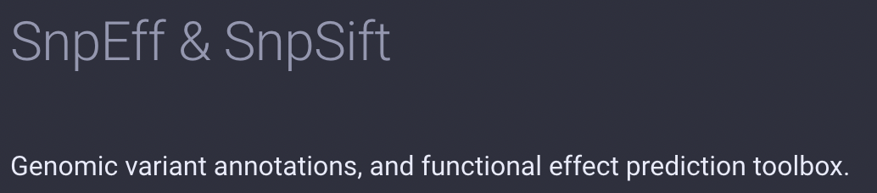
Tools for Variant Analysis
Variant Calling
Genomic Analysis Toolkit (GATK)
Variant Annotation and Prioritization
SnpEff and SnpSift

Slide 19


Tools for Variant Analysis
Variant Calling
Genomic Analysis Toolkit (GATK)
Variant Annotation and Prioritization
SnpEff and SnpSift
Variant Visualization
Integrative Genomics Viewer
cBioPortal

Slide 20

Logistics

Slide 21
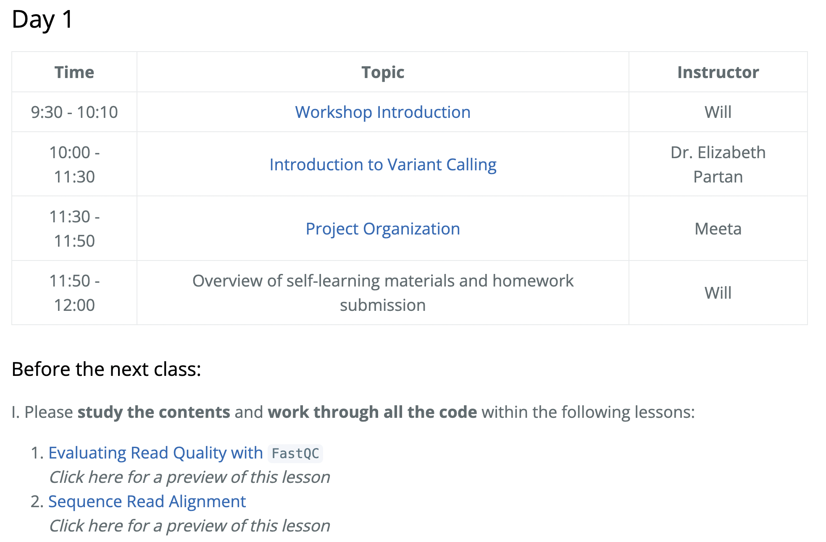
Course schedule
https://tinyurl.com/Intro-to-variant-analysis

Slide 22
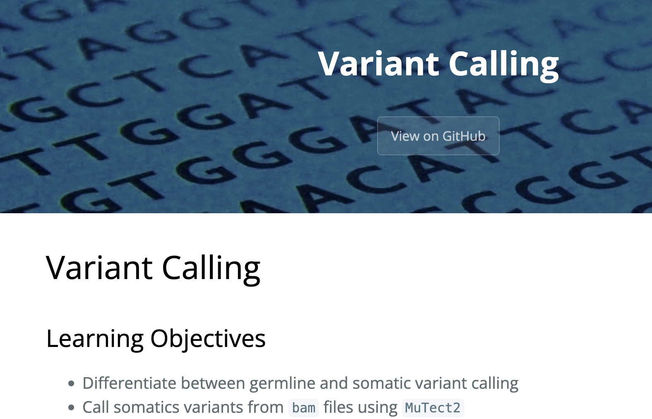
Course materials
We continuously update our materials to reflect changes in the field/software
https://tinyurl.com/Intro-to-variant-analysis

Slide 23

Course participation
Mandatory review of self-learning lessons and assignments
Attendance required for all classes
Your questions and active participation drive learning
We look forward to all of your questions!

Slide 24
Course participation
At-home lessons and exercises after each session
Cover material not previously discussed
Provides us feedback to help pace the course appropriately
3-5 hours to complete
Homework load is heavier in the beginning of this workshop series and tapers off

Slide 25
Using AI for Assignments
Do
Try to resolve error messages with it
Test code written by AI on a dataset where you have expected results
Take the time to review the generated code line-by-line
Don’t
Implement it in replacement to learning
Write code that you don’t understand
Assume the output from an AI process is correct

Slide 26


Odds & Ends
Quit/minimize all applications that are not required for class
Name tags
Post-its
green - I am all set
red - I need time/help
Phones on vibrate/silent
Bathrooms

Slide 27
Thanks!
Kathleen Chappell and Andy Bergman from HMS-RC
Data Carpentry
These materials have been developed by members of the teaching team at the Harvard Chan Bioinformatics Core (HBC). These are open access materials distributed under the terms of the Creative Commons Attribution license (CC BY 4.0), which permits unrestricted use, distribution, and reproduction in any medium, provided the original author and source are credited.

Slide 28

Contact Us
HBC training team: hbctraining@hsph.harvard.edu
HBC consulting: bioinformatics@hsph.harvard.edu
O2 (HMS-RC): rchelp@hms.harvard.edu

